Slide 1




EARLY LIFE ADVERSITY REVEALS ADAPTIVE USE OF ABSORPTION INTO MUSIC
Trends
Nicholas Kathios*, Kelsie Lopez*, Laurel Gabard-Durnam, Psyche Loui
Ads
24 August 2023 Presented by Nicholas Kathios ICMPC 2023

Slide 2

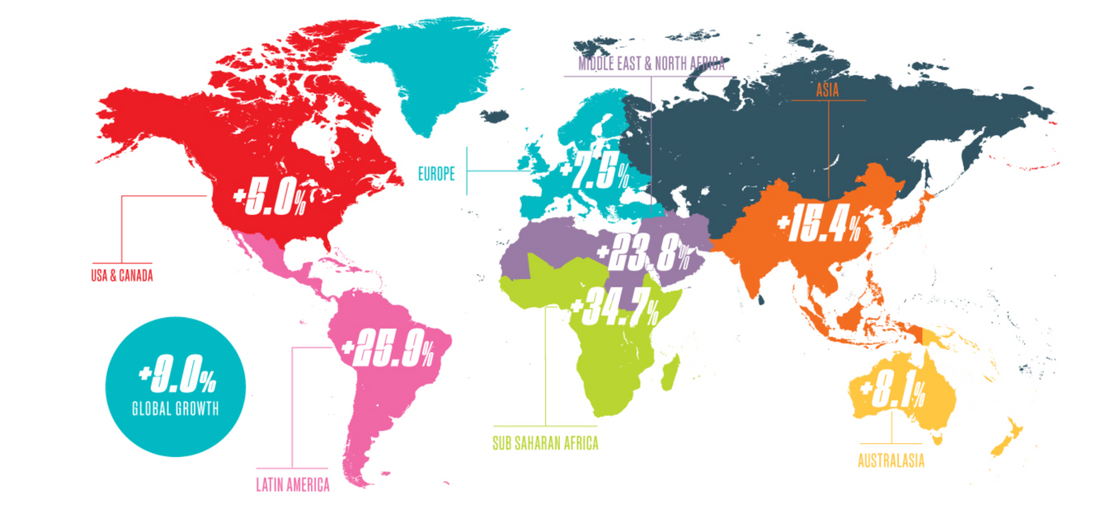


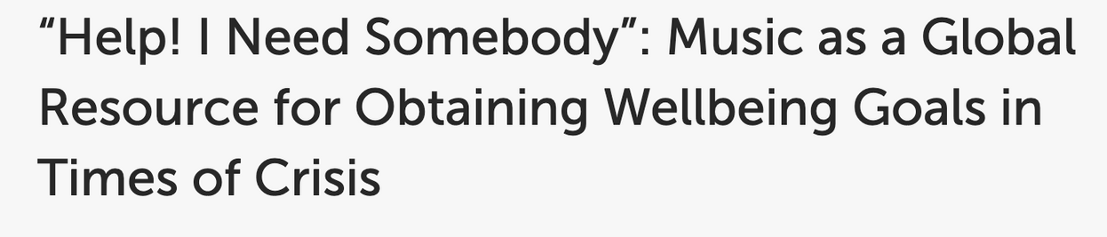

2
e.g. Granot, Spitz et al., 2021; Hennessy et al., 2021; Krause et al., 2021; Thoma et al., 2012; Ziv & Hollander-Shabtai, 2021
Notes:
Around the globe, individuals listen to a TON of music. A recent report has revealed that global music consumption increased by 9% from 2021 to 2022, with average hours of music consumed increasing from 18 to over 20 hours per week. One highly cited reason why individuals listen to music is for mood regulation: this is especially apparent in the wake of the COVID19-pandemic, which confirmed music’s ability to down regulate negative emotions in stressful contexts.

Slide 3
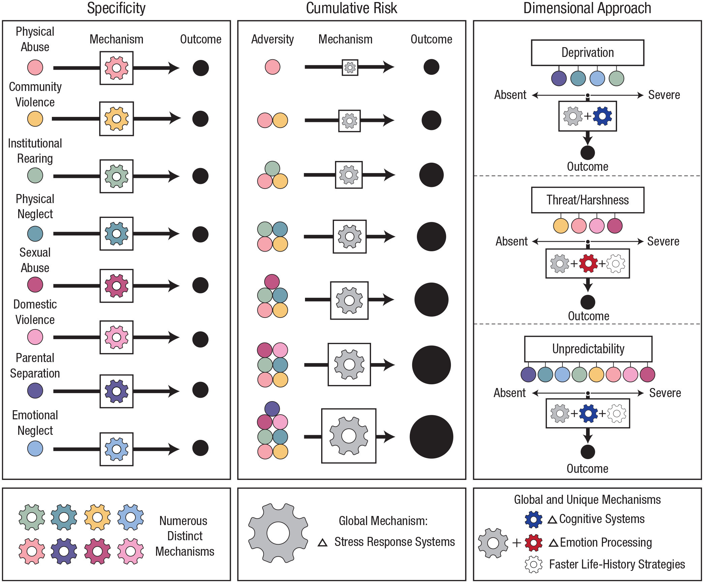

EARLY LIFE ADVERSITY: CUMULATIVE RISK
In general, greater exposure to ELA results in higher vulnerability to mental illness & lower resilience as adults ….
Assumptions:
distinct adversities act upon the same mechanism
each experience has equal & additive outcomes
McLaughlin et al., 2021
3
Notes:
While these studies examine how music usage effectively regulate negative emotions in response to a global stressful event, another way we can measure the presence of stress in individuals’ lives is through measuring exposure to early life adversity, which has a rich history of cross-species work. In this context, early life adversity refers to a broad set of negative experiences in early life, such as physical abuse or parental separation. Historically, one popular approaches to study the effects of such experiences in development on adult behavior is the “cumulative risk” model, which essentially treats each experience as a binary (present or absent), and is a count-based measure of how much adversity and individual has experienced. Now while this may seem like a rather broad-strokes measure, this approach has shown us that exposure to adverse experiences does put individuals at greater risks for mental illnesses and lower resilience as adults. However, this model does not offer much insight into how these experiences translate into these downstream effects because of its two key assumptions …

Slide 4
EARLY LIFE ADVERSITY: DIMENSIONAL MODELS
Goal: identify core dimensions of experiences that occur in multiple types of adversity
absence of expected environmental input
exposure to or risk of physical
or psychological harm
stochastic variation in the environment
McLaughlin et al., 2021
4
Notes:
Recently, however, evidence has suggested that there are core dimensions that are shared across multiple types of adversity. As a result, the dimensional model of ELA aims to measures potential shared mechanisms across separate experiences of adversity. Current research suggests there are three such dimensions of adverse experiences: deprivation, threat, and unpredictability. Not only does this approach give a bit more mechanistic clarity than the cumulative risk model, but it also extends the binary of present/absent to measure the experiences of adversity as continuous measures as a function of both severity and chronicity of these experiences. This is the approach we will be using in the current study.

Slide 5



HOW MIGHT EXPOSURE TO ELA IMPACT MUSIC USAGE?
Exposure to adverse environments (across dimensions)
Improved adult mental health
More incentive to engage in regulatory behavior
Higher music usage for regulation as an adult
2
Notes:
So how might these experiences relate to music usage? Well, in the same way in which COVID19 was a stressful context in which individuals turned to music, we believe that individuals who experience adverse home environments—across all dimensions—might ….
And, as mentioned previously, as ELA is an antecedent of mental illness, if individuals who are exposed to ELA turn to music as a way to regulate, then it might also be the case that such behaviors might be related to improved adult mental health.

Slide 6

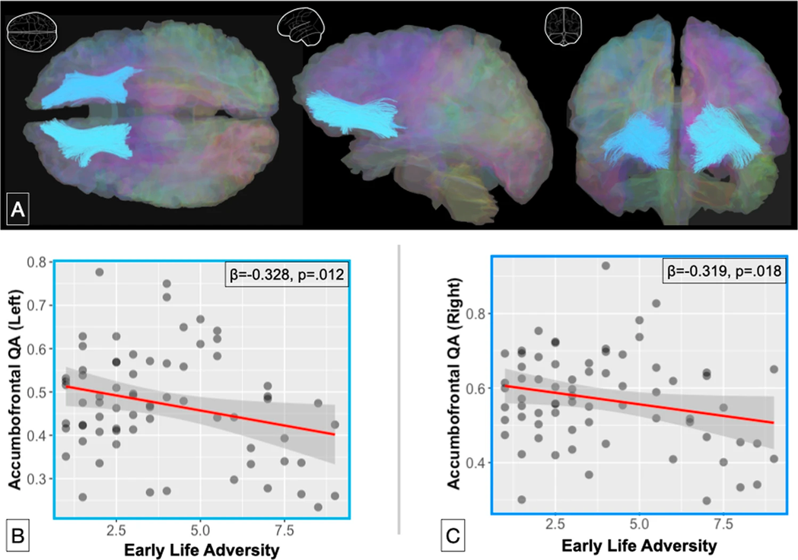
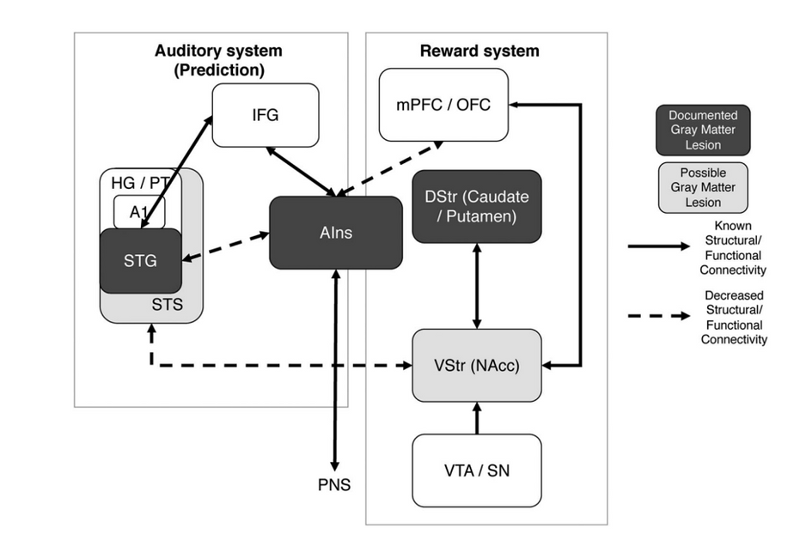
EARLY LIFE ADVERSITY & REWARD PROCESSING
e.g. Dennison et al., 2019; Glynn et al., 2018; Kennedy et al., 2021
2
Notes:
However, this picture might not be as clear cut as I’ve made it out to be. A considerable degree of the positive emotions music evokes is due to its ability to engage the brain’s reward system, which relies heavily on learned reward predictions, as outlined in the neuroanatomical model I’ve included on my slide. Interestingly, one important neural connection between
Altered reward-learning
Higher risk of general anhedonia (esp. unpredictability)

Slide 7
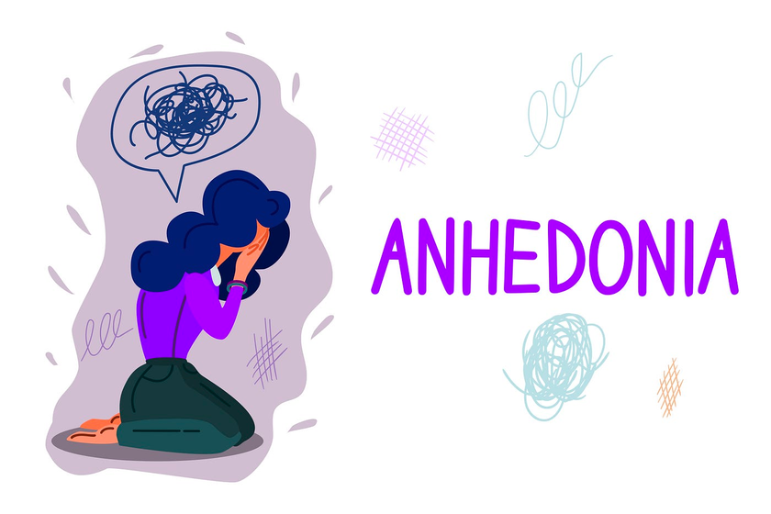

HOW MIGHT EXPOSURE TO ELA IMPACT MUSIC USAGE?
Exposure to adverse environments
Implicated development of reward system & reduction in reward responsivity
Less music enjoyment & usage of music for regulation
2

Slide 8

PARTICIPANTS
254 participants (140F) recruited from a previous experiment
Extended Barcelona Music Reward Questionnaire (eBMRQ):
Emotion Evocation
Mood Regulation
Music-Seeking
Social Reward
Sensorimotor Reward
Absorption
STUDY 1 METHODS
2

Slide 9


ADVERSITY MEASURES
UNPREDICTABILITY
DEPRIVATION
THREAT
Confusion, Hubbub, and Order Scale
(CHAOS)
Questionnaire of Unpredictability in Childhood
(QUIC)
McLaughlin Deprivation and Threat Scales
"At least one of my caregivers changed jobs frequently."
"At home we can talk to each other without being interrupted."
"How often did you not have regular meals to eat?"
"How often did a caregiver threaten to abandon you as a child?"
Childhood (6-12)
Adolescence (13-18)
Glynn et al. 2019; Matheny et al., 1995; McLaughlin et al., 2014
2

Slide 10
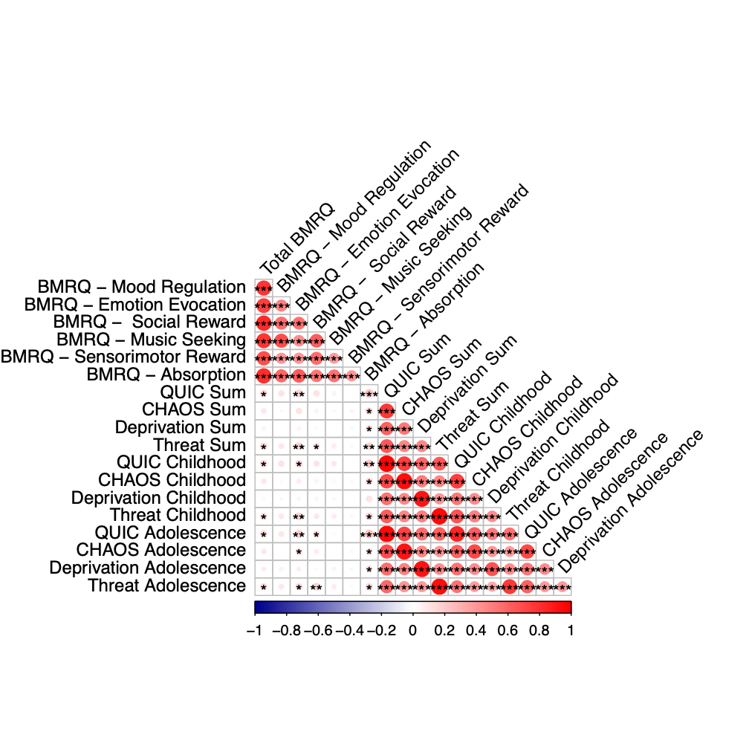
ALL DIMENSIONS OF ELA ARE POSITIVELY ASSOCIATED WITH REPORTS OF ABSORPTION INTO MUSIC
Absorption: an individual’s ability and willingness to allow music to draw them into an emotional experience
“While listening to music, I may become so involved that I may forget about myself and my surroundings.”
2
Notes:
add p-value stuff

Slide 11
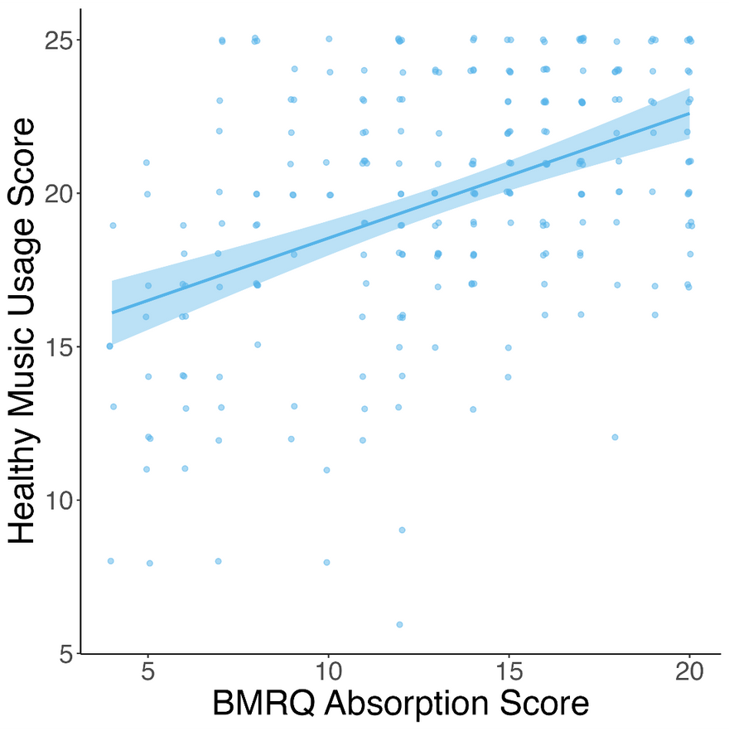
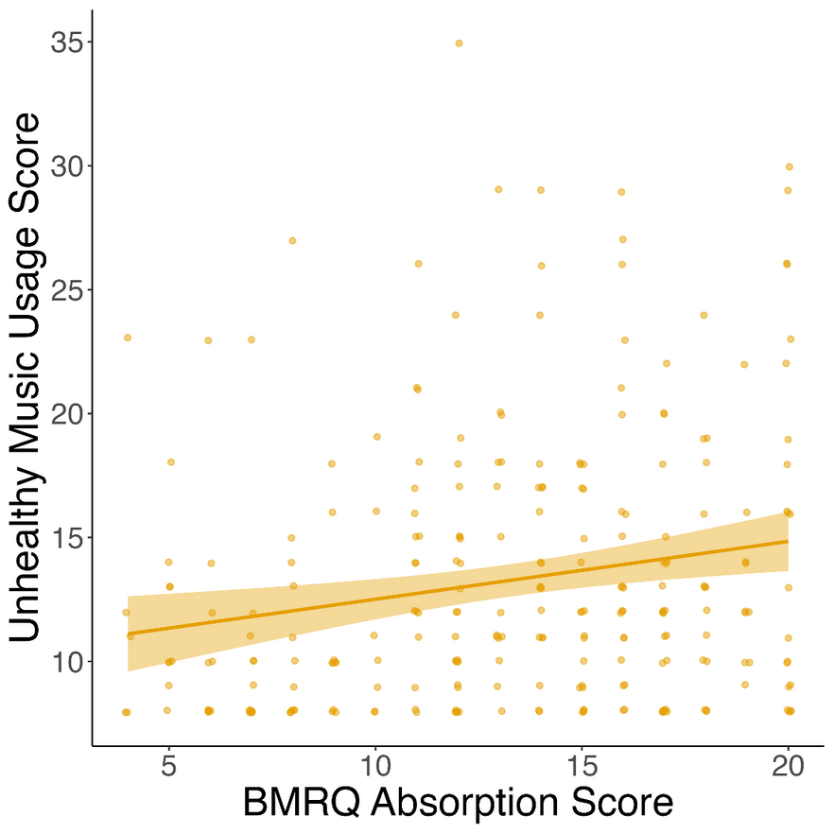
ABSORPTION INTO MUSIC POSITIVELY RELATED TO BOTH HEALTHY & UNHEALTHY MUSIC USAGE....
r = 0.44, p < 0.001
r = 0.19, p = 0.002
2

Slide 12
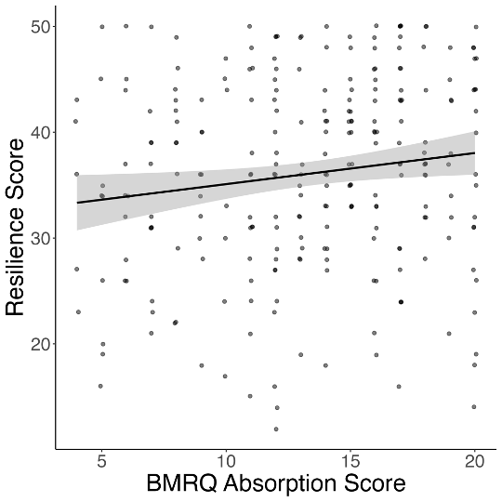
ABSORPTION ALSO POSITIVELY RELATED TO RESILIENCE
r = 0.14, p = 0.02
2

Slide 13
WHY IS ABSORPTION ADAPTIVE? TAKING A CLOSER LOOK AT ITEMS ON THE HEALTHY-UNHEALTHY SCALE
I hide in my music because nobody understands me, and it blocks people out
When I listen to music I get stuck in bad memories
When I try to use music to feel better I actually end up feeling worse
I like to listen to songs over and over even though it makes me feel worse
Music makes me feel bad about who I am
Music gives me an excuse not to face up to the real world
It can be hard to stop listening to music that connects me to bad memories
Music leads me to do things I shouldn’t do
2

Slide 14
WHY IS ABSORPTION ADAPTIVE? TAKING A CLOSER LOOK AT ITEMS ON THE HEALTHY-UNHEALTHY SCALE
I hide in my music because nobody understands me, and it blocks people out
When I listen to music I get stuck in bad memories
When I try to use music to feel better I actually end up feeling worse
I like to listen to songs over and over even though it makes me feel worse
Music makes me feel bad about who I am
Music gives me an excuse not to face up to the real world
It can be hard to stop listening to music that connects me to bad memories
Music leads me to do things I shouldn’t do
2

Slide 15
IS ABSORPTION INTO MUSIC
ADAPTIVE IN ADVERSE CONTEXTS BECAUSE IT ALLOWS INDIVIDUALS TO 'ESCAPE' THESE CONTEXTS?
Trends
Ads

Slide 16
PARTICIPANTS
288 participants (141F) recruited from a previous experiment
STUDY 2 METHODS
MEASURES
Same adversity measures as Study 1
BMRQ
Absorption in Music Scale (AIMS)
Escapism Scale
2

Slide 17
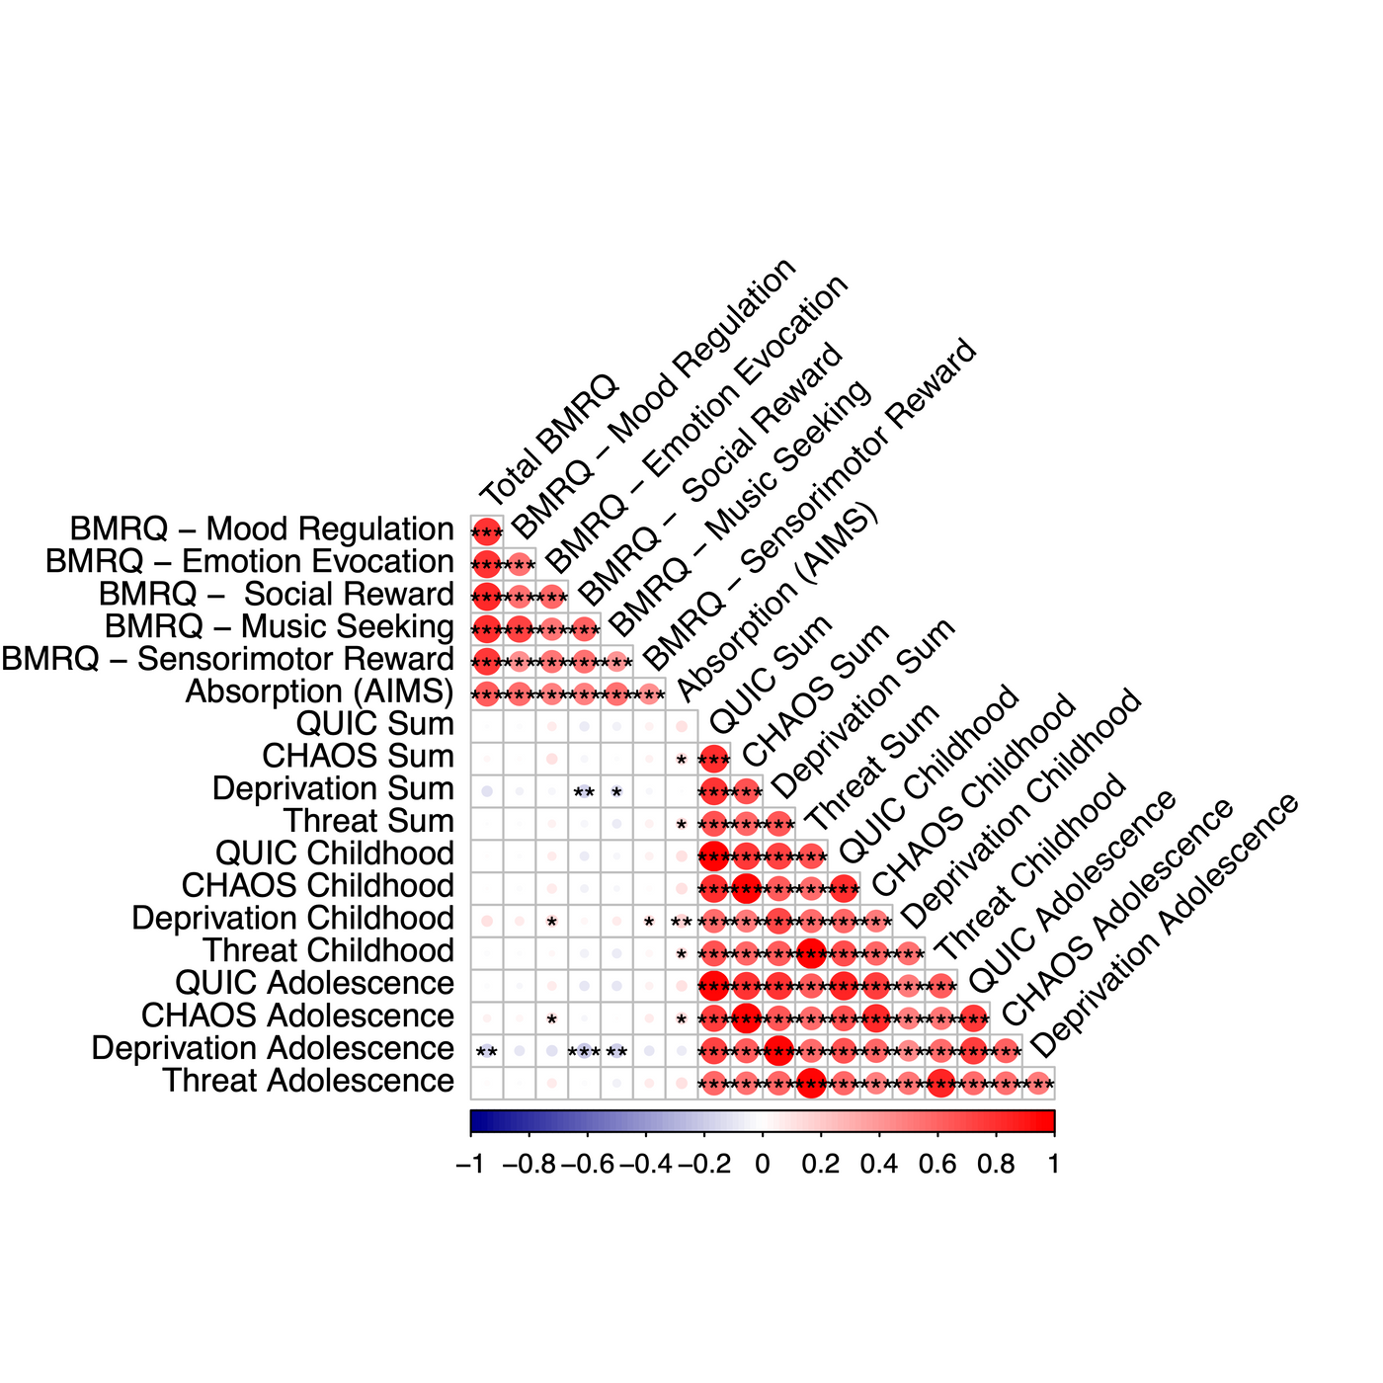
CONCEPTUAL REPLICATION OF CHAOS & THREAT ASSOCIATIONS WITH ABSORPTION (VIA AIMS)
2

Slide 18
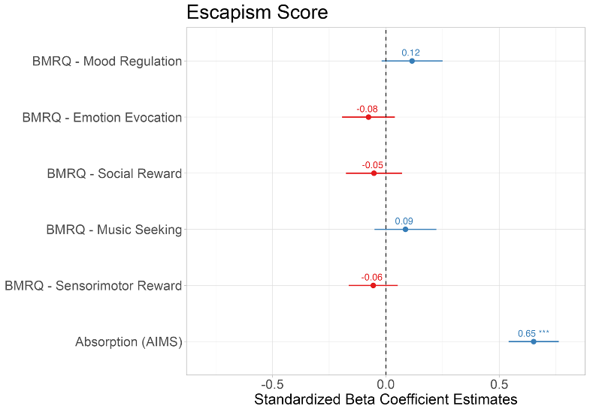
ABSORPTION INTO MUSIC ASSOCIATED WITH USING MUSIC FOR ESCAPISM
Escapism ~ Mood Regulation + Emotion Evocation + Social Reward + Music Seeking + Sensorimotor Reward + Absorption
2

Slide 19
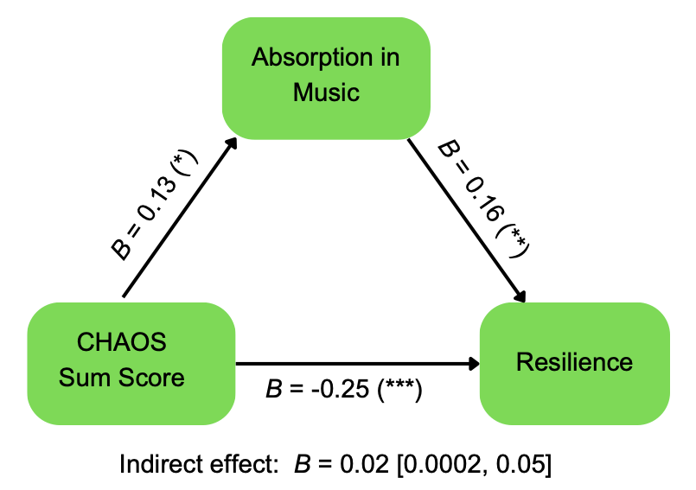
ABSORPTION MEDIATES THE RELATIONSHIP BETWEEN CHAOS AND RESILIENCE
AIMS scores did not mediate this relationship for childhood CHAOS scores (indirect effect: B = 0.02 [-0.001, 0.05]), but it did for adolescent CHAOS scores (indirect effect: B = 0.02 [0.001, 0.05]).
2

Slide 20
DISCUSSION
Individuals who report experiencing early life adversity also report being highly absorbed by music.
This relationship is observed in retrospective reports of both childhood and adolescence experiences.
“Escaping” adverse contexts into music is one way individuals with ELA develop resilience.
AIMS did not mediate the relationship between exposure to threat and resilience because it is likely not advantageous to psychologically escape these contexts.
CHAOS – AIMS – Resilience mediation driven by adolescent CHAOS scores, likely due to increased agency in music listening during this time.
2

